Slide 1
Review Sprint 4 PIVOANE PIéton, Vitesse, dOs d’ANE
OUR TEAM
Sara Bassanetti
Emeline Delhay
Luiz Renato Rodrigues Carneiro
Léa Scheer
Yuchen Xia
TUTORS
Gwendoline Le Corre
Thierry Monteil
Notes:
Hi everyone, we are going to present you our review of sprint 4 of PIVOANE project.

Slide 2







TABLE OF CONTENT
1
3
5
7
PRODUCT DESCRIPTION
STORIES /
DEMONSTRATIONS
SCHEDULE CONTROL
SPRINT 5
OBJECTIVES OF SPRINT 4
ORGANISATION OF SPRINT 4
FMECA &
DEFAULT TREES
2
6
2
4
Notes:
As usual, we'll remind you today what is our product and what was the objectives of this sprint. We will show you our demonstrations, the organization and the schedule controle of sprint 4. Lea will present you our FMECA and default trees and to finish we'll describe the objectives of sprint 5.

Slide 3


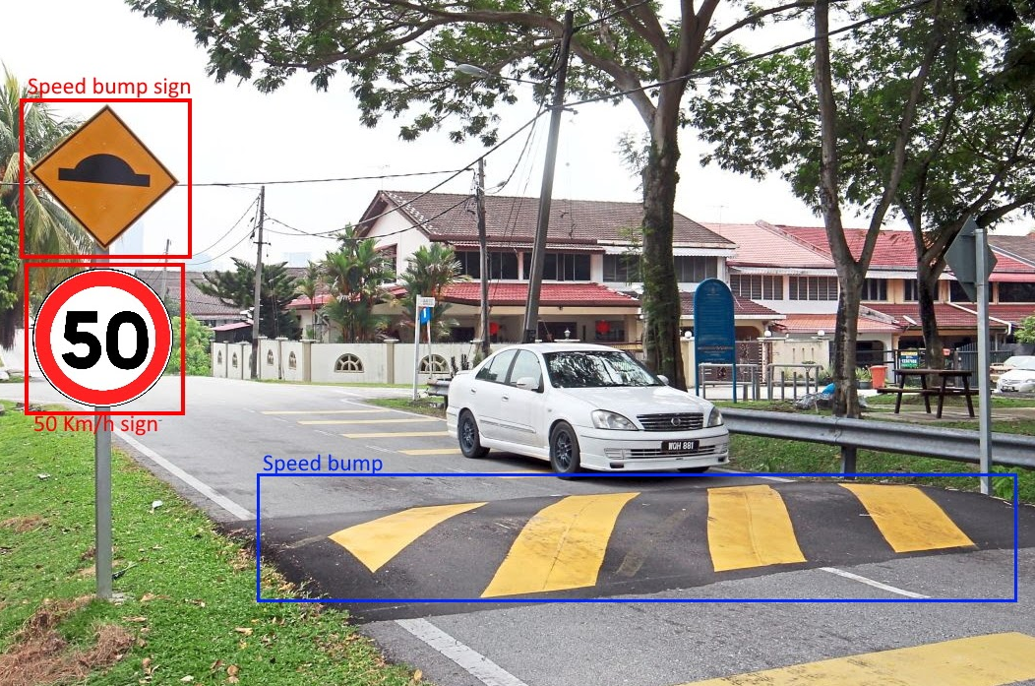



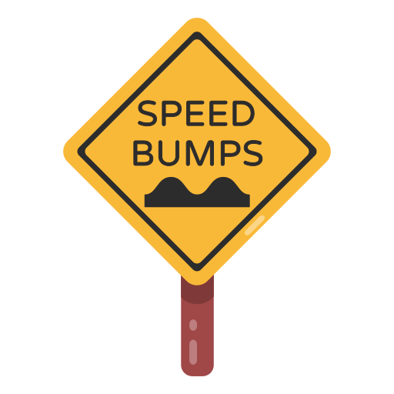

PRODUCT DESCRIPTION
Adapt the car's behavior according to the environment detected in different complex situations
Adjust the speed of the car when a road sign is detected
Stop the car when there are pedestrians on the road
Slow down when approaching a crosswalk or speed bump
3
Notes:
After this Christmas break, lets make a little reminder of our product. We are working on an autonomous car which have to detect its environment and react correctly in different complex situation. We are focusing in adjust the speed when road sign is detected, stop the car when a pedestrian is crossing the road and adjust the behavior of the car with speed bump on the road.

Slide 4




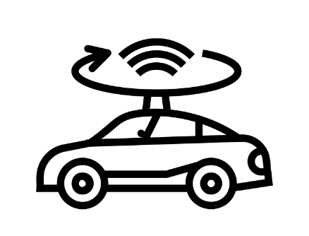
OBJECTIVES OF SPRINT 4
Finish linking camera to Raspberry Pi
Ensure working link, with readable data
Optimisation of datasets
Increase the diversity of data
Lidar detection
Detect obstacles using the Lidar
4
4
Notes:
For sprint 4, we had 3 main goals.
We had to link camera and Raspberry PI and improve our AI model. We had also to use LIDAR detection
I'll let's now Emeline talking about our first user story

Slide 5





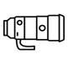

STORY 1
Road signs detection
Place a road sign in front of the car
React to road sign
30 speed
Stop
50 speed
Bump
5
5
Notes:
Like Sarah said, our first user story was to link the camera detection to the car behavior. It’s something Luiz and I worked mainly on. If you remember, during the last review we had planned to do our demonstration outside, on a real road. However it’s something we will not do, due to some factors Luiz will talk about later.
So today, the car will stay on its stool for the demo. Now we are going to switch screen with Luiz, who is going to show you the image detection part on his computer. And you will quickly see the main reason why we are not doing an outdoor demo. As you can see, right now, we have not yet started the car and the camera detection is working real-time with no problem. However when we start the car, like Luiz is doing right now, the camera start to slow down, and we have up to six seconds delay, which is not really safe for an autonomous car.
Now, we will show different road signs to the car, so speed signs, speed bump and stop. The delay is quite obvious, but else, the car behavior is exactly what is expected. We can also add a pedestrian in front of the car, which it will prioritize. Now, I will let Luiz talk about our detection precision, and the problems we encountered during this sprint.

Slide 6
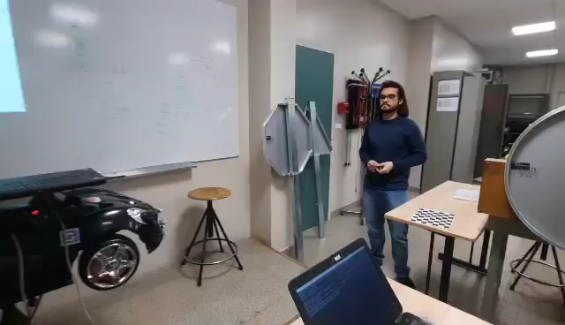
DEMONSTRATION
6
6

Slide 7
STORY 1
Operational requirements:
Detect obstacles 5 meters away in front of the car, and identify it in 2 to 5 seconds
Detect all our road signs
10 images used for each test and panel
30 speed
Stop
50 speed
Bump
Accuracy for normal nearby signs (d<5 m)
100 %
100 %
100 %
100 %
Accuracy for far away normal signs (5 m<d<7 m)
100 %
100 %
100 %
100 %
Accuracy for signs in anormal conditions
80 %
70 %
90 %
60 %
7
7

Slide 8





STORIES DIFFICULTIES
Reflash Operational System Image in Raspberry
Docker changes the camera ID
Delay between Raspberry and Computer
Network connection between Raspberry and Computer
8
8

Slide 9


STORY 1
Measure distance
Measure distance using boarding box
Operational requirement:
React at sign level
Measure sign
Take picture at known distance
Measure sign on picture
9
9
Notes:
Part of the first user story was also to measure the distance between the car and the road sign when detected. It was needed to answer the requirement needing to react at the road sign level.
To do it, we used the triangle similarity theorem to calibrate our calculator. It something pretty easy to implement, we just had to measure our road signs size in real life, then take pictures of them at a known distance. In our case we did mutliple shots at 1m, 1m20 and 1m50. Then, measure the road signs size on the pictures (more precisely the number of pixels). With a simple formula, we can then determine the focal length of the camera. And later on, with the focal length, the size in pixel of the sign, the real size of the size, we can find its distance.
We were able to create this small program, however it was not implemented in the demo you saw for three main reasons. First, due to the delay, the car would receive the distance value at the wrong time, which is not really helpful. Second, with the car on the stool the sign never get closer which would confuse the car. Lastly, our measurement precision is a little off. We based all our calculus on the road sign real size, however, the pixel size of the sign is in reality the boarding box size, which is most of the time bigger than the sign. Due to this, the distance are often short of 30cm, but with far away sign, it can go up to 1m. For next sprint we will have to improve this measure by trial and error by adding an offset to balance the boarding box size.

Slide 10



Pedestrian Safety
Pedestrian detection accuracy
Operational requirement:
Stop at 30 centimeters from an obstacle
100 % accuracy with moving and still pedestrians
Stop at 40 to 30 centimeters
10
10
Notes:
Finally, another requirement was for our car to stop at 30cm from any obstacles. We tested our car behavior with unmoving and moving pedestrians. Given we don’t a huge amount of data, we tested it 10 times for each type of pedestrian, which resulted in a 100 % accuracy and a car stopping at 40 to 30 centimeters from the obstacle.
Now, I will let Yuchen talk about the second user story.

Slide 11








STORY 2
Threshold = 50 %
mAP = TP/(TP+FP)
Optimisation of datesets
Place a road sign in front of the car
Identify road signs and pedestrians
Class​ | mAP [%]​
Pedestrian​ | 89.33​
Stop Sign​ | 99.72​
50 km/h​ | 59.29​
30 km/h​ | 67.37​
Speed bump​ | 99.7​
1500+
Class​ | mAP [%]​
Pedestrian​ | 95.8
Stop Sign​ | 100​
50 km/h​ | 100
30 km/h​ | 82.8
Speed bump​ | 100
500+
11
11

Slide 12

ORGANIZATION OF SPRINT 4
DECEMBER
JANUARY
CHRISTMAS
BREAK
First week
Second week
Linking camera & behavior
Fixing car
Improving delay
Optimizing dataset
& IA model
Create environment
Implementing
FMECA
Task difficulty
12
12
Notes:
Let talk about the task organization of this sprint. As usual, we divided the tasks in two groups with the AI part and the automation part. Lea an Emeline worked on the automation part with the 3 first tasks in this diagram. They begin to work on implementing behavior of the car according to different complex situations. They worked on this one first because there is the most difficult part of the sprint for them. They worked also on calculate the distance that the car travel and when these two tasks were achieved they linked the both. It means the car behaves as we want when we want, at the level of the sign on the road.
Yuchen Luiz and I worked on the AI part with the 3 last tasks you can see. We start with creating our dataset because it was the longest tasks of the sprint. We trained the AI model just after that. We also implement the AI ros node and try to link camera detection and behavior of the car.

Slide 13


SCHEDULE CONTROL
DONE
• Optimization of datasets and AI model
• Fully linking
• Estimation of distances
PLANNED
• Finish linking camera to Rasperry Pi
• Optimization of datasets and AI mode by increasing the diversity of data
• LIDAR detection for moving obstacles
NOT PLANNED BUT DONE
• Implementing the FMECA
• Fixing the car
NOT DONE
• LIDAR detection
13
13
Notes:
So, there is our schedule control. As you can see, we planned for this sprint to train AI model on new road signs and to detect them. We also planned to implement car's behavior using state machine and to link the camera detection with the behavior.
We succeed to achieve the 3 first points. Indeed, we are able to detect and make the difference with 4 types of road signs and pedestrian using the camera. We are also able to control the car in different complex situations.
Unfortunately, we still have some issues to link completely the camera and the behavior of the car. We have 2 nodes, one for the AI part and one controlling the behavior of the car but for the moment the AI node is not sending all the data we need to link camera detection and the right behavior of the car. So we planned to achieve this for the next sprint and Emeline will explain that to you later.

Slide 14
14
14
Notes:
So, there is our schedule control. As you can see, we planned for this sprint to train AI model on new road signs and to detect them. We also planned to implement car's behavior using state machine and to link the camera detection with the behavior.
We succeed to achieve the 3 first points. Indeed, we are able to detect and make the difference with 4 types of road signs and pedestrian using the camera. We are also able to control the car in different complex situations.
Unfortunately, we still have some issues to link completely the camera and the behavior of the car. We have 2 nodes, one for the AI part and one controlling the behavior of the car but for the moment the AI node is not sending all the data we need to link camera detection and the right behavior of the car. So we planned to achieve this for the next sprint and Emeline will explain that to you later.

Slide 15
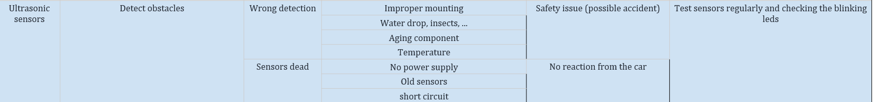
FMECA : Failure Mode, Effect and Criticality Analysis
Component | Function | Failure mode | Cause | Effect | Detection
Camera | See the car environment | Camera dead | Broken cable, not connected, too old, ... | No detection of the environnement | While testing camera, while launching the car if no data detection, verifying the cable
 |  | Wrong angle | Broken support, twisted (eg. hit something) | No detection of the environnement or detect not every objects | Verifying the camera angle at the start
 |  | Image quality deterioration | Broken lense, obstruction with something, bad luminosity | Bad efficiency of detection | Seeing the image on the computer
Ultrasonic sensors | Detect obstacles | Wrong detection | Improper mounting | Safety issue (possible accident) | Test sensors regularly and checking the blinking leds
 |  |  | Water drop, insects, ...
 |  |  | Aging component
 |  |  | Temperature
 |  | Sensors dead | No power supply | No reaction from the car
 |  |  | Old sensors
 |  |  | short circuit
Wheels motor | Control car’s speed and direction | Motor malfunction | Mechanical failure | Wrong car behavior | While using the car
 |  |  | Bad orientation | Damaged car, steering angle quite important
Battery | Provide power to the car | Low battery | Battery depleted | Car speed reduced and can damage other components | Verify battery level regularly
 |  | Battery dead | Old battery Connectivity issue | Car stops | Display 0V, car stops and power off
 |  | Battery leaking | Manufacturing defect | Safety issue | technical inspection
Wheels sensors | Measure number of wheel revolution to calculate speed and distance | Sensor malfunction | Obstruction of the ray | Wrong speed/distance calculation | Bad car behavior
 |  | Sensor dead or disconnected | Short circuit Old component | No feedback on car speed and distance traveled | No car reaction nor data on the computer
Computer | Process camera data to detect signs | No detection | No network | Car disconection | Terminal crashing
 |  |  | Computer battery dead |  | Computer turned off
 |  | Wrong detection | AI model precision | Random behavior | Visually
 |  | Big delay for detection | Too much data to process | Bad timing behavior
15
Notes:
AMDEC (Analyse des Modes de Défaillance, de leurs Effets et de leur Criticité) and default trees analysis are tools used to identify potential failure modes and their causes in a product or system.
In the context of developing an autonomous car, AMDEC and default trees analysis can help identify and evaluate potential failure modes in various systems and components, such as the sensors, communication systems, and control algorithms that are used to enable autonomous driving. For example, an AMDEC analysis might identify a potential failure mode in the ultrasonic sensors used to detect obstacles.

Slide 16
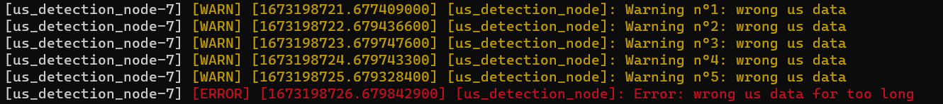
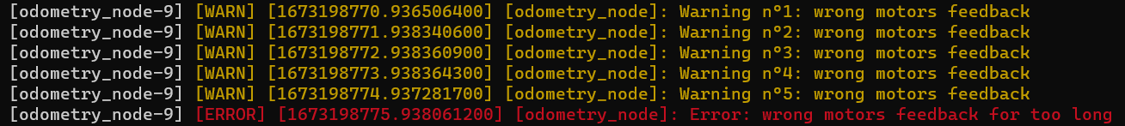



FMECA Implementation
16

Slide 17
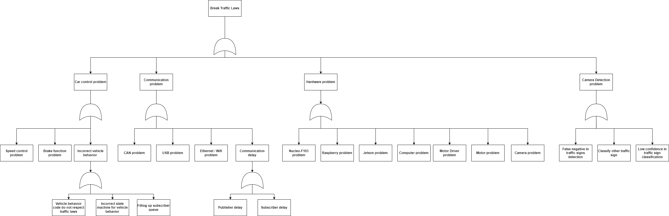
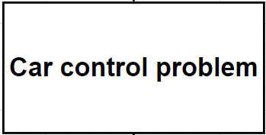
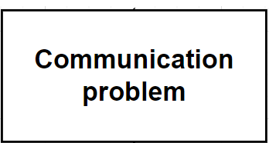
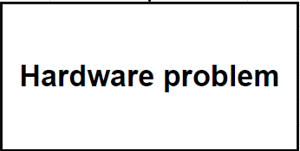
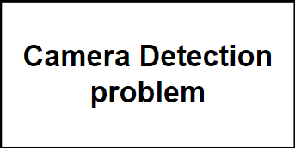
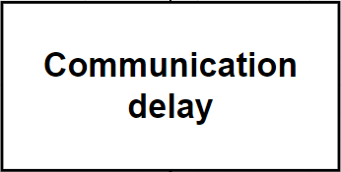
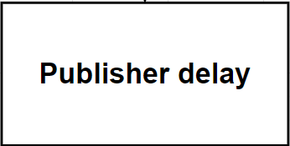
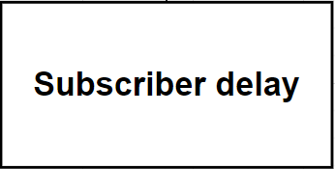
Default Tree : break traffic laws
17

Slide 18
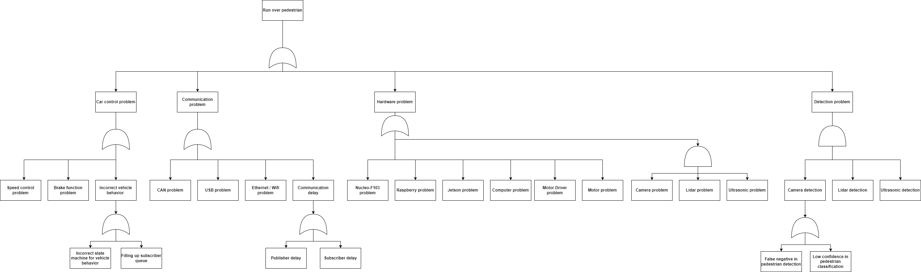
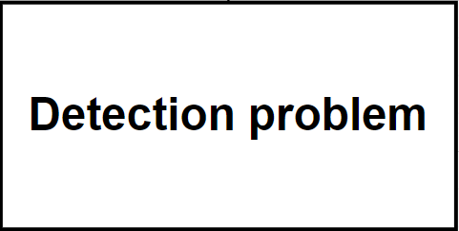

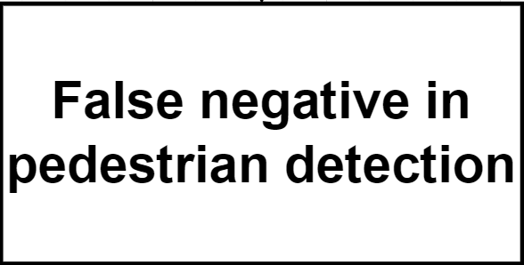
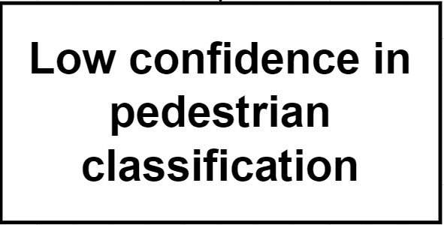
Default Tree : run over pedestrian
18
Notes:
Similarly, a default tree analysis could be used to identify potential failure modes in the communication systems used to exchange data between with autonomous car

Slide 19


FMECA & Default Trees Analysis impact on the product development
Implement code to handle as many failure cases as possible
SAFETY
RELIABILITY
19
Notes:
Those tools are helpful to design and develop reliable autonomous cars. Overall, AMDEC and default trees analysis can be valuable tools for improving the reliability and safety of autonomous cars, helping to ensure that these vehicles can operate safely and effectively in a variety of conditions.

Slide 20



OBJECTIVES OF SPRINT 5
Take into account the delay of communication
Try to manage the delay to react in good times
React when camera detects a pedestrian
Implement behavior when detecting a pedestrian with camera
Test in real environment
Using our created situation
20
20
Notes:
I'll present you our objectives for our last sprint. We'll have to reduce the delay to react in good times. We'll also improve pedestrian detection linking camera detection with ultrasonic. To demonstrate everything we have implemented on the car, we'll test in a real environment.

Slide 21



OBJECTIVES OF SPRINT 5
User Story 1: Take into account the delay of communication
Calculate the delay of communication precisely
Consider the delay to measure distances
If we can, reduce as much as we can the delay
21
21
Notes:
For this first user story, we have to reduce the delay of the car to have the right reaction at the right moment. So, we'll have to calculate precisely the delay and considered the distance with it. So when we'll have this data, we'll focus on reducing as much as we can this delay.

Slide 22

OBJECTIVES OF SPRINT 5
User Story 2: React when camera detects a pedestrian
Detect moving obstacles
React accordingly
1m
22
22
Notes:
For the moment, we are able to react with a pedestrian using ultrasonic and we are able to detect a pedestrian with the camera. For this last sprint, we'll link the both detection to be more precise and ensure more safety. So when the car is detecting a pedestrian, it will have to stop 1m away using at the same time ultrasonics and camera detection.

Slide 23
OBJECTIVES OF SPRINT 5
User Story 3: Test in real environment
Ensure all requirements are respected :
Steering angle < 10°
React as soon as the
sign is reached
Install a real test environment in front of the GEI on approximately 20m of road
23
23
Notes:
To finish and to test all our user story for this sprint, we'll set up a real environment. The car will have to respect all our operational requirement, in particular react as soon as the sign is reached.

Slide 24
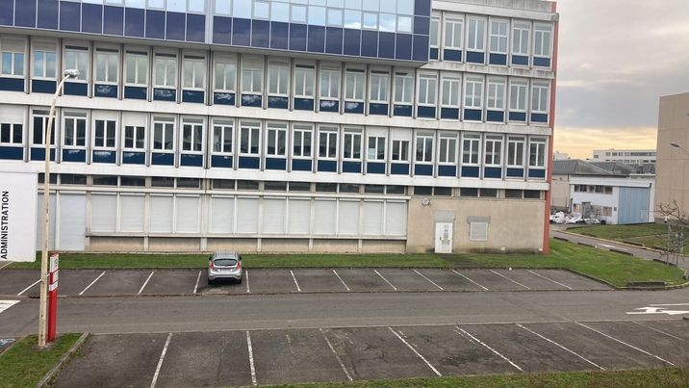

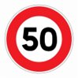

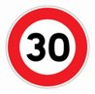

20m
Notes:
There is what will be our test environment. We'll set up the road sign in front of this building and you can see with the video how the car will have to react. Also we can add pedestrian when we want on the way of the car and it will have to stop.

Slide 25


SUMMARY
Sprint 4:
Sprint 5:
Finish link between camera and Raspberry Pi
Optimize the delay problem
Improve AI model
Carry out the field test
Create a real environment for
detection
React when camera detects a pedestrian
25
25
Notes:
So, to sum up, during this sprint we succeeded in linking the camera and Raspberry PI and improving our AI model. We also implement FMECA safety on the car and create a real environment for detection.
For the next sprint, we will have to reduce the delay of communication and react when a pedestrian is detecting using camera and ultrasonic sensors. To finish, we'll have to carry out the car in our real environment test.
The presentation is finish, if you have any questions or feebacks, feel free to tell us

